Slide 1
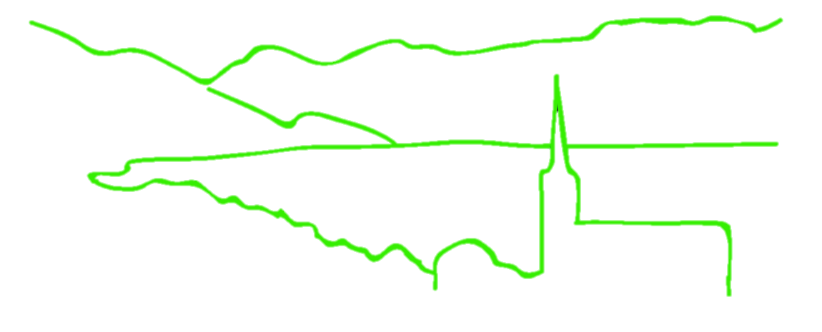
The bioinformatics of reduced representation libraries: RADseq and beyond
B @ G³
i
o
i
n
for
o
r
m
a
t
i
c
s
d
a
p
t
a
t
i
o
n
e
n
o
m
i
c
s
Jonathan B. Puritz
Marine Science Center
Northeastern University

Slide 2

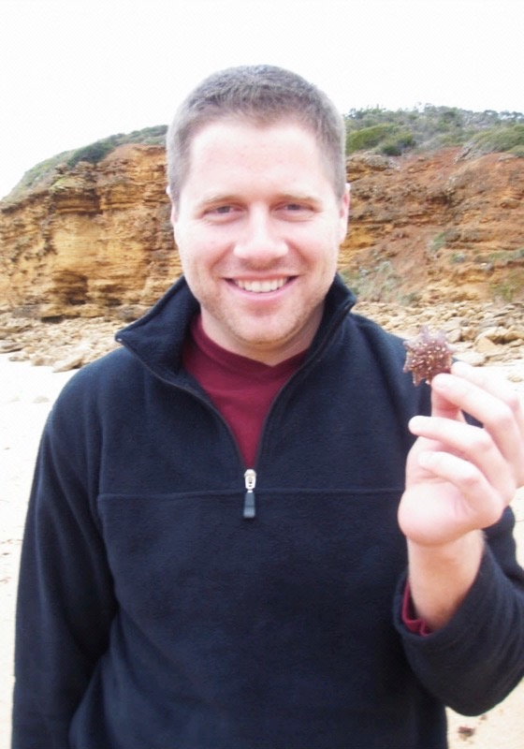
A little info on me
B.S. Biology (2005)
Brown University
PhD Zoology (2011)
University of Hawaii
Hawaii Institute of Marine Biology
Influences of coastal pollution and life history on the population connectivity of Asterinid sea stars
B@G 2017

Slide 3
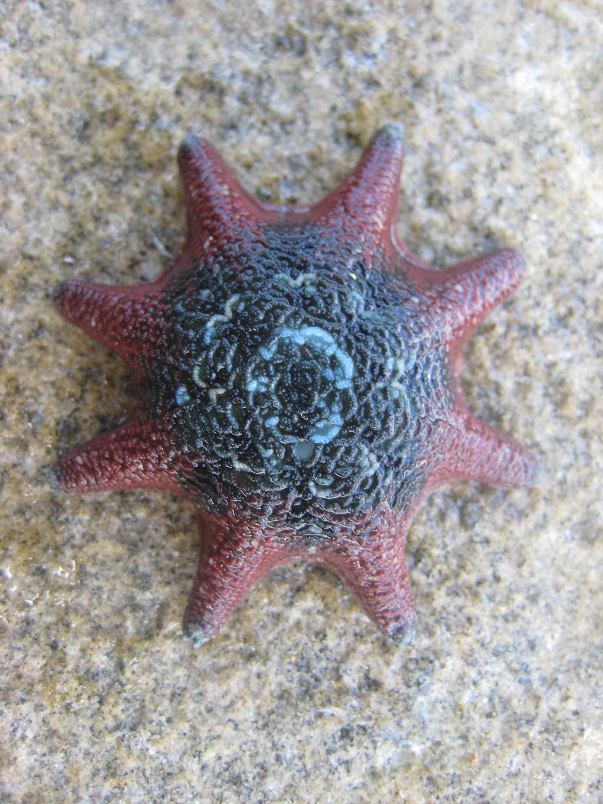
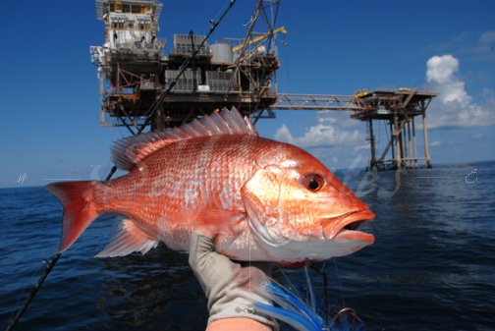
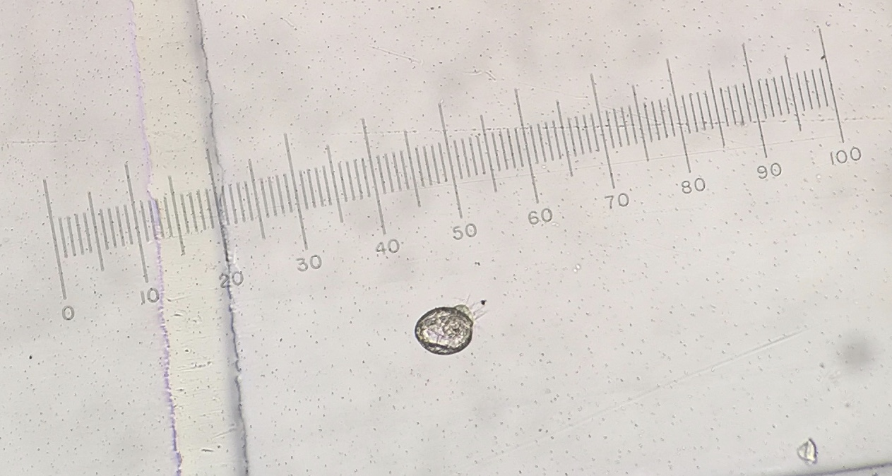
A little info on me
B.S. Biology (2005)
Brown University
PhD Zoology (2011)
University of Hawaii
Hawaii Institute of Marine Biology
Postdoc (2012-2016)
Texas A&M Corpus Christi
Postdoc (2016-2017)
Northeastern University
Assistant Professor (Aug 2017- )
University of Rhode Island
B@G 2017

Slide 4
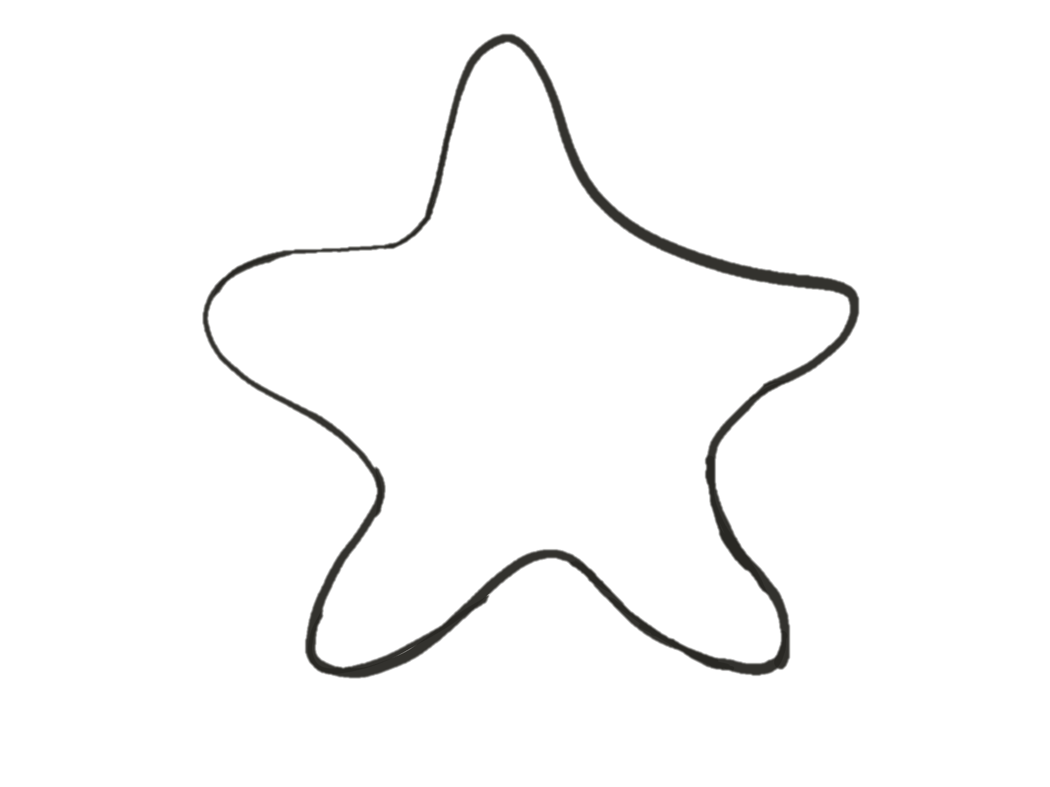
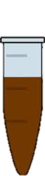
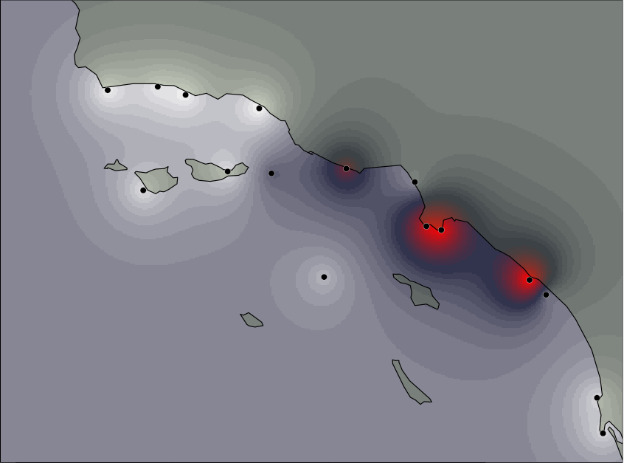
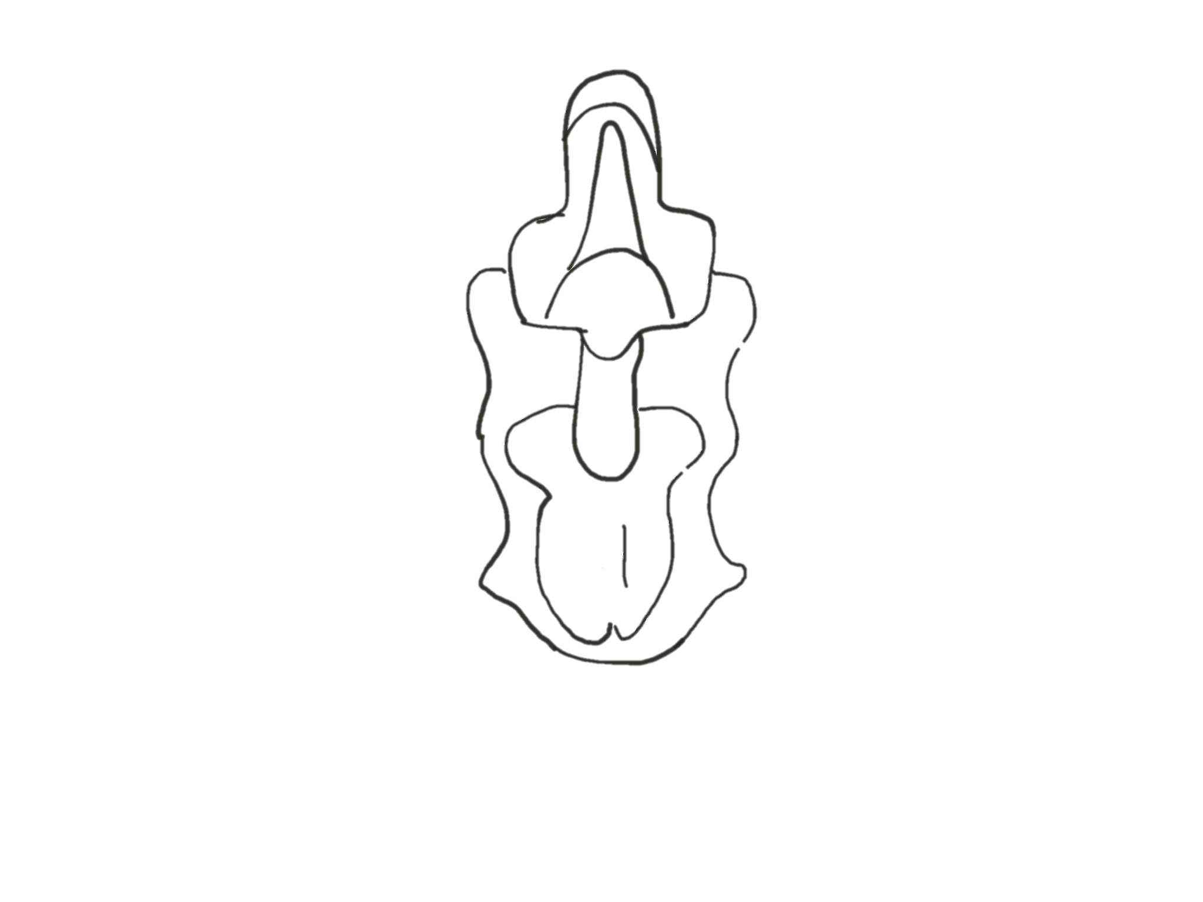
My Research Program
NGS
Bioinformatics
Connectivity
Selection
Seascape Genomics
Terminal
$ bash
$ python

Slide 5
Next generation experience
Amplicon 454 Sequencing
Method to simultaneously sequence 10 loci for 20 individuals across 16 localities
Puritz et al. 2012, Puritz and Toonen 2013, Puritz et al. In Prep
ezRAD
Method using a single restriction digest and Illumina TruSeq kits
Toonen et al. 2013, Puritz and Toonen In Prep
ddRAD
Slight modifications of the Peterson et al. method
dDocent
Any ezRAD/ddRAD analysis pipeline for population genomics
Puritz et al. 2014, Puritz et al. In Prep
B@G 2017

Slide 6
“Advice is a form of nostalgia. Dispensing it is a way of fishing the past from the disposal, and wiping it off, painting over the ugly parts, and recycling it for more than it’s worth.”
-Baz Luhrmann

Slide 7
NGS Output
B@G 2017

Slide 8
NGS Workflow
dDocent
SNPs
FASTQ
B@G 2017

Slide 9
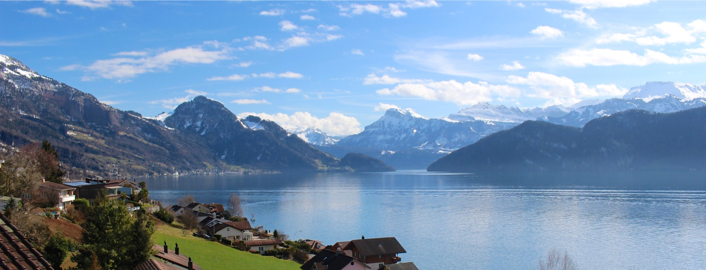
Today’s Workshop

Slide 10
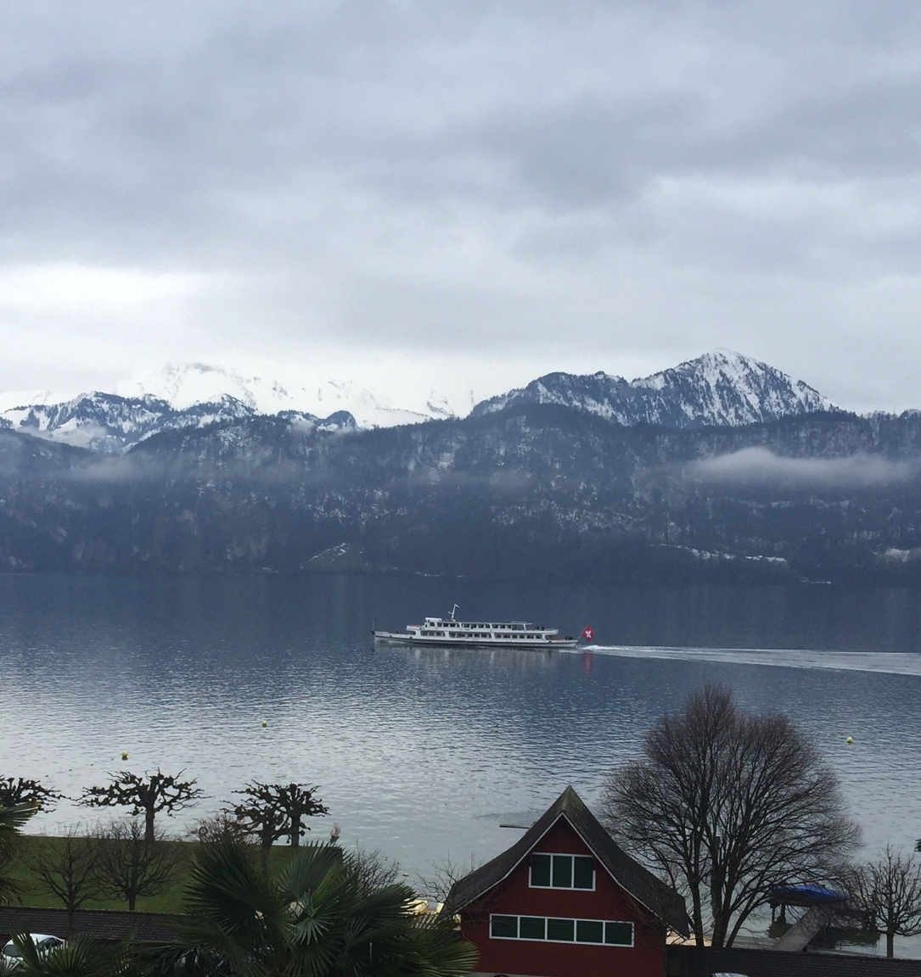
Today’s Workshop
dDocent
VCF
FASTQ
Lectures
Intro to RADseq
RADseq methods, bias, and experimental design
RADseq data pipelines and bioinformatic challenges
Exercises
Reference Assembly
Ref.Ex
Read Mapping
Map.Ex
Live demonstration of dDocent
SNP Filtering
Filter.Ex
B@G 2017

Slide 11
What is RADseq?
B @ G³
i
o
i
n
for
o
r
m
a
t
i
c
s
d
a
p
t
a
t
i
o
n
e
n
o
m
i
c
s

Slide 12
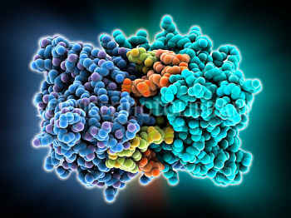
The “R” is for Restriction Enzyme
5’
GATC
3’
3’
CTAG
5’
GATC
3’
5’
5’
3’
CTAG

Slide 13
Genomic DNA
5’
3’
3’
5’

Slide 14
Restriction Enzyme 1
5’
3’
3’
5’

Slide 15
Restriction Enzymes 1 and 2
5’
3’
3’
5’

Slide 16
Digested DNA

Slide 17
Reduced Genome Representation

Slide 18
The beginning and end of each locus is known
LOCUS 1
LOCUS 2
LOCUS 3

Slide 19
The beginning and end of each locus is known
LOCUS 1
LOCUS 2
LOCUS 3

Slide 20
The beginning and end of each locus is known
LOCUS 1
LOCUS 2
LOCUS 3

Slide 21
Barcoding
LOCUS 1
LOCUS 2
LOCUS 3

Slide 22
Pooling

Slide 23
NGS Workflow
dDocent
SNPs
FASTQ
B@G 2017

Slide 24
Single Nucleotide Polymorphism (SNP)
AATTCACCTCGGGTATCTTCAGGAAAACGGTCAAAATCAGGTTTCACAGTATATTGGACTCCTC
AATTCACCTCGGGTATCTTCAGGAAAACGGTCAAAATCAGGTTTCACAGTATATTGGACTCCTC
AATTCACCTCGGGTATCTTCAGGAAAACGGTCAAAATCAGGTTTCACAGTATATTGGACTCCTC
AATTCACCTCGGGTATCTTCAGGAAAACGGTCAAAATCAGGTTTCACAGTATATTGGACTCCTC
AATTCACCTCGGGTATCTTCAGGAAAACGGTCAAAATCAGGTTTCACAGTATATTGGACTCCTC
AATTCACCTCGGGTATCTTCAGGAAAACAGTCAAAATCAGGTTTCACAGTATATTGGACTCCTC
AATTCACCTCGGGTATCTTCAGGAAAACAGTCAAAATCAGGTTTCACAGTATATTGGACTCCTC
AATTCACCTCGGGTATCTTCAGGAAAACAGTCAAAATCAGGTTTCACAGTATATTGGACTCCTC
AATTCACCTCGGGTATCTTCAGGAAAACAGTCAAAATCAGGTTTCACAGTATATTGGACTCCTC
AATTCACCTCGGGTATCTTCAGGAAAACAGTCAAAATCAGGTTTCACAGTATATTGGACTCCTC

Slide 25
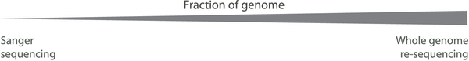
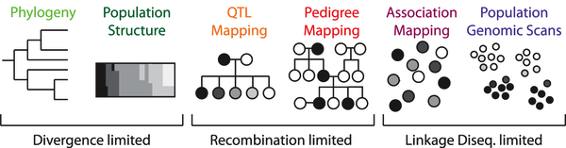
RAD: what is it good for?
modified from Peterson et al. 2012
Reduced representation of the genome allows for inexpensive and rapid genotyping of dozens to hundreds of samples
The ability to survey neutral and adaptive genomic variation

Slide 27
Sex-biased dispersal
One sex exhibits philopatry (side fidelity)
Typically males monogamous species
Typically females in polygamous species
While the other sex is dispersive
Conflicting forces acting on the genome
Dispersive sex is homogenizing much of the genome
bi-parentally inherited parts of the genome
If there is environmental variation in natal habitat, localized selection could lead to increased reproductive success for the philopatric sex

Slide 28
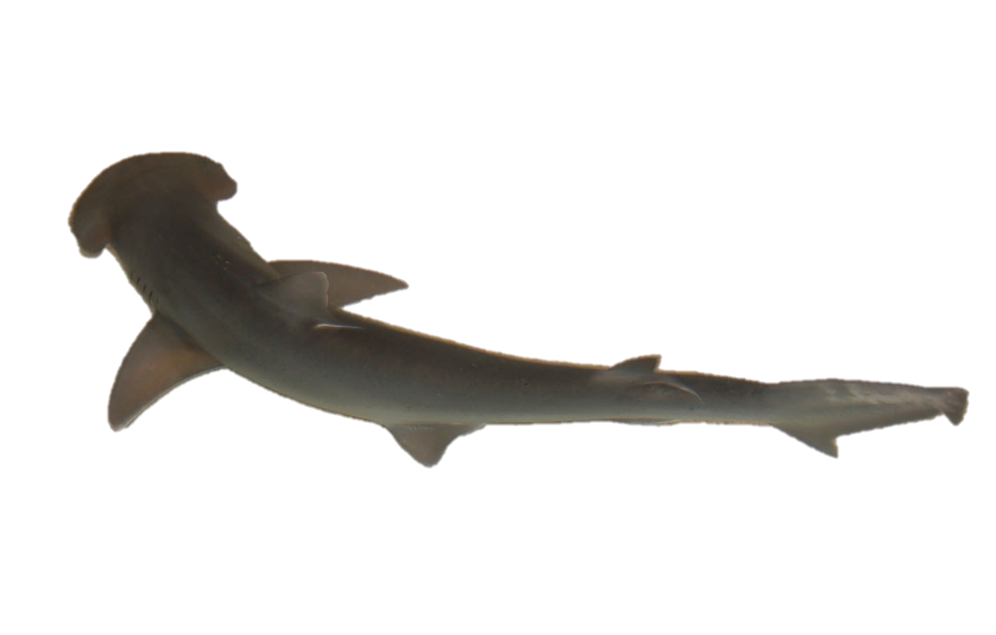
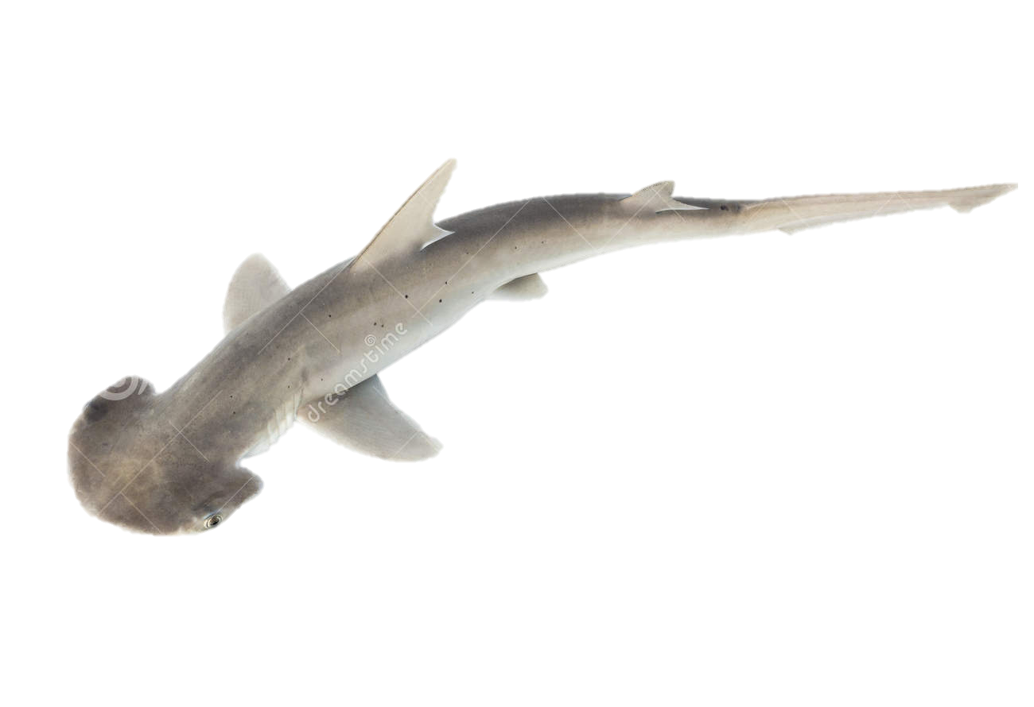
Bonnethead Sharks (Sphyrna tiburo)
Found in coastal waters of western Atlantic and Gulf of Mexico
Known to use nearshore habitat for gestation and parturition
Thought to exhibit female philopatry
extensive maternal investment
natal habitats differ substantially
Significant differences in life history among across geographic regions
Size at age
Growth rate
Size and age at maturity

Slide 29
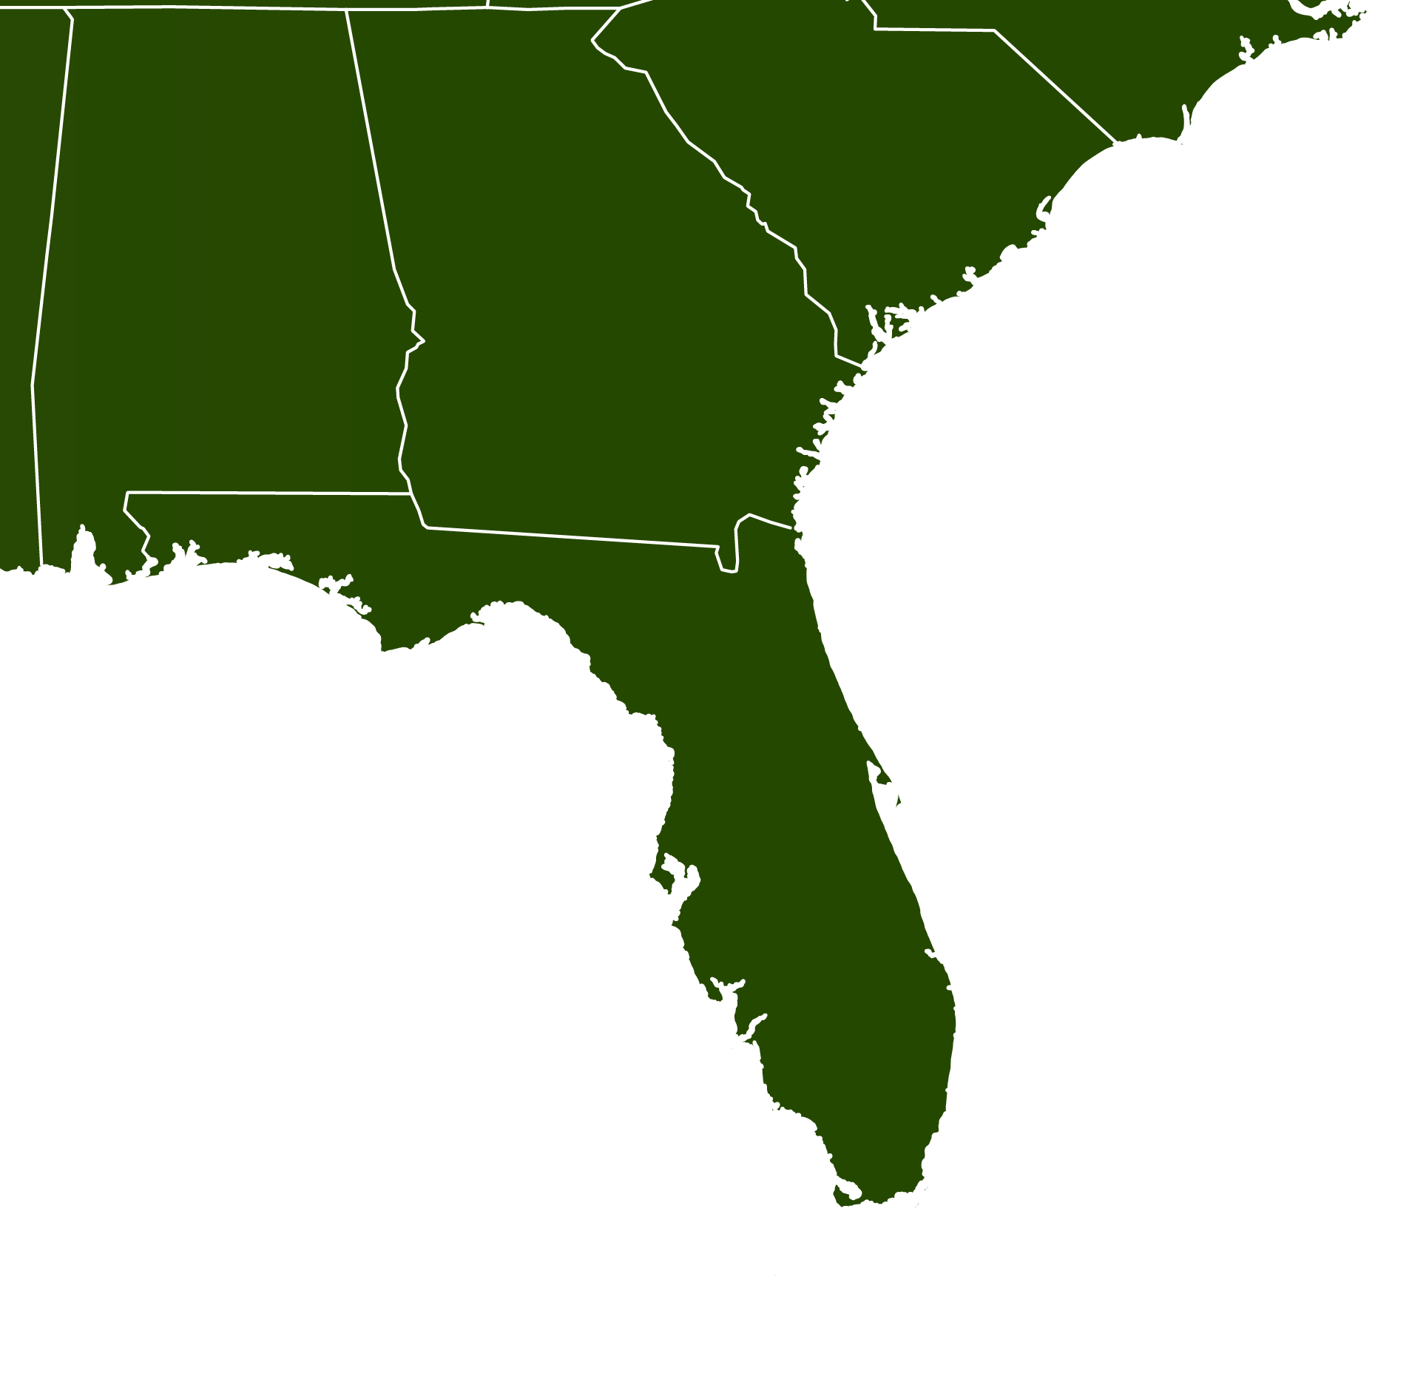
Bonnethead Population Genomics
Surveyed 134 individuals from 4 different localities
ddRAD sequencing
Sanger sequencing
NC
22
PC
36
TB
31
FB
31

Slide 30
RAD data
Quality Filtering
De Novo Assembly
Read Mapping
SNP Calling
SNP Filtering
SNPs were filtered by genotype depth, allelic balance, HWE, average locus depth, and a variety of other bioinformatics
5,914 SNPs haplotyped into 3,967 RAD loci across 121 individuals

Slide 31
F_{ST} across all loci

Slide 32
F_{ST} across all loci

Slide 33
F_{ST} across all loci

Slide 34
RAD data
Quality Filtering
De Novo Assembly
Read Mapping
SNP Calling
SNP Filtering
SNPs were filtered by genotype depth, allelic balance, HWE, average locus depth, and a variety of other bioinformatics
5,914 SNPs haplotyped into 3,967 RAD loci across 121 individuals
BayeScan found 30 outlier loci that were putatively under selection

Slide 35
Bonnethead DAPC
Neutral
NC
22
PC
36
Outlier
TB
31
FB
31

Slide 36
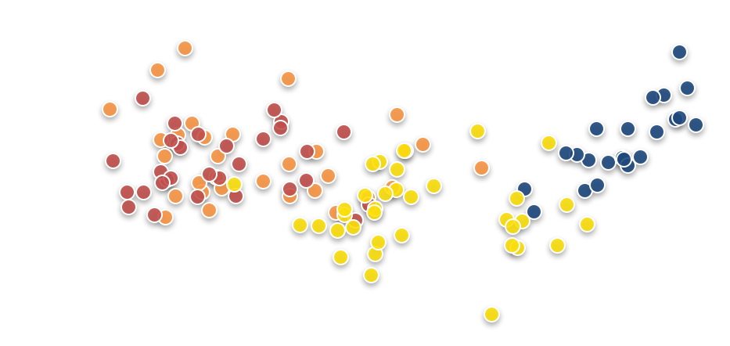
Drivers of outlier allele frequencies
NC
22
PC
36
TB
31
FB
31

Slide 37
Drivers of outlier allele frequencies
NC
22
PC
36
TB
31
FB
31
18 O-SNP loci had r² values ≥ 0.90
Explained 75.6% of X axis variation

Slide 38
Breaking RAD: Limitations of RADseq for studying adaptation
B @ G³
i
o
i
n
for
o
r
m
a
t
i
c
s
d
a
p
t
a
t
i
o
n
e
n
o
m
i
c
s

Slide 39
Limited by linkage and enzyme choice
5’
3’
3’
5’
Adaptive locus will be missed by RADseq Analysis!

Slide 40
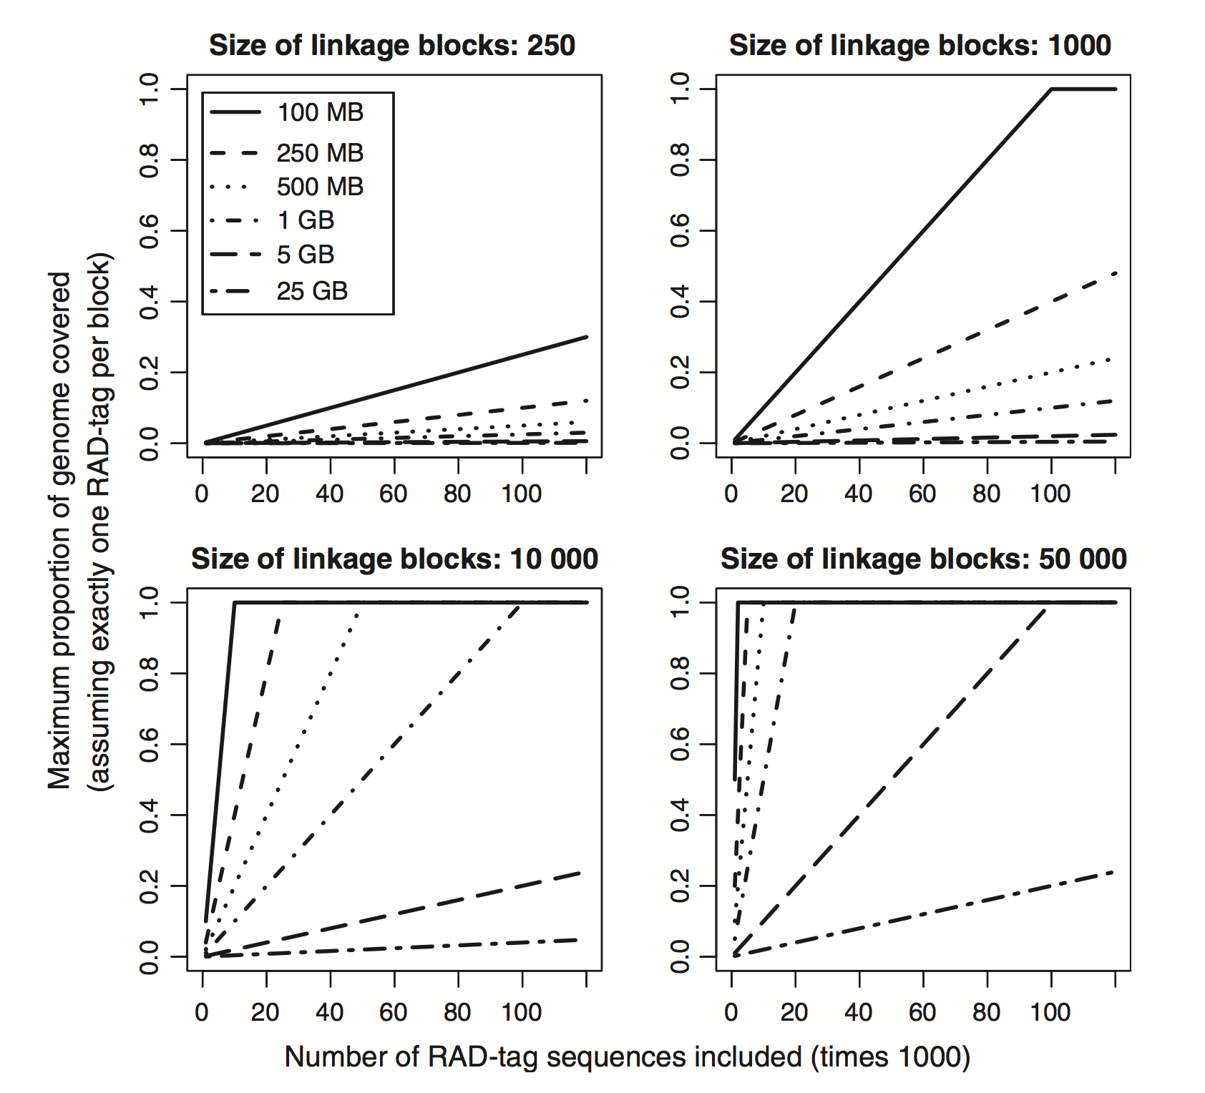
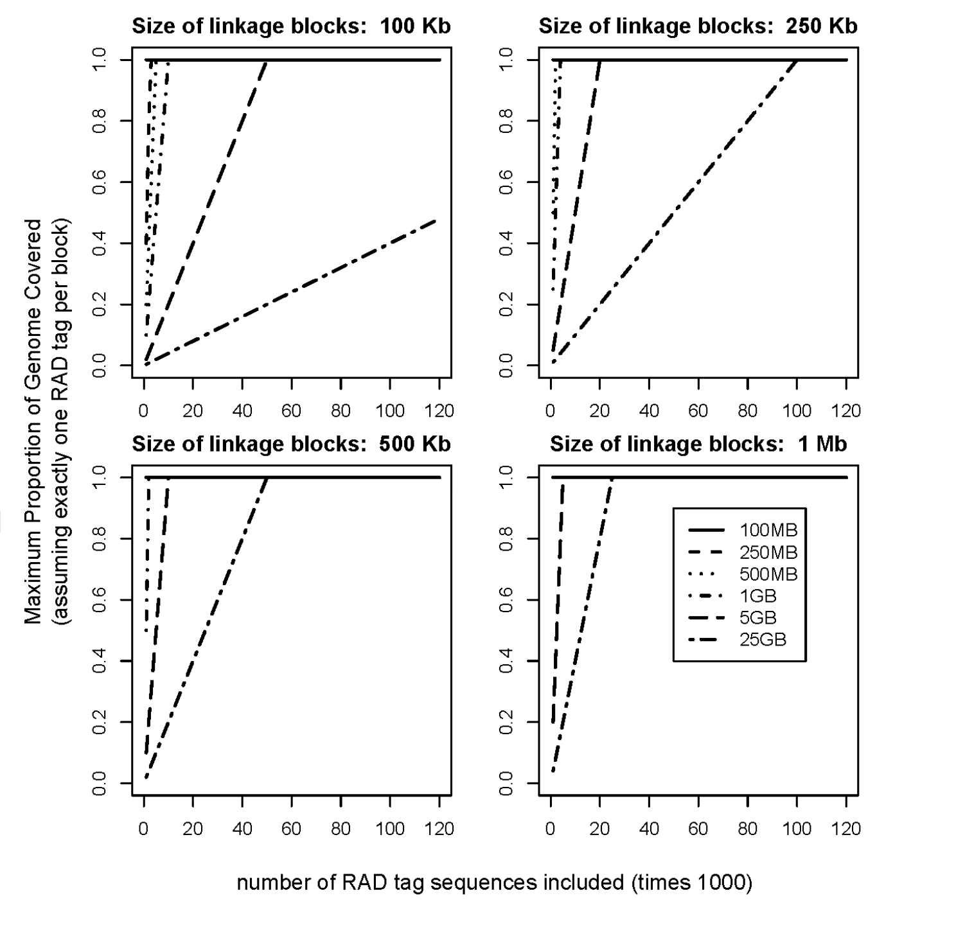
Size of linkage blocks impact chance of detection
Lowry et al. 2016
McKinney et al. 2016

Slide 41
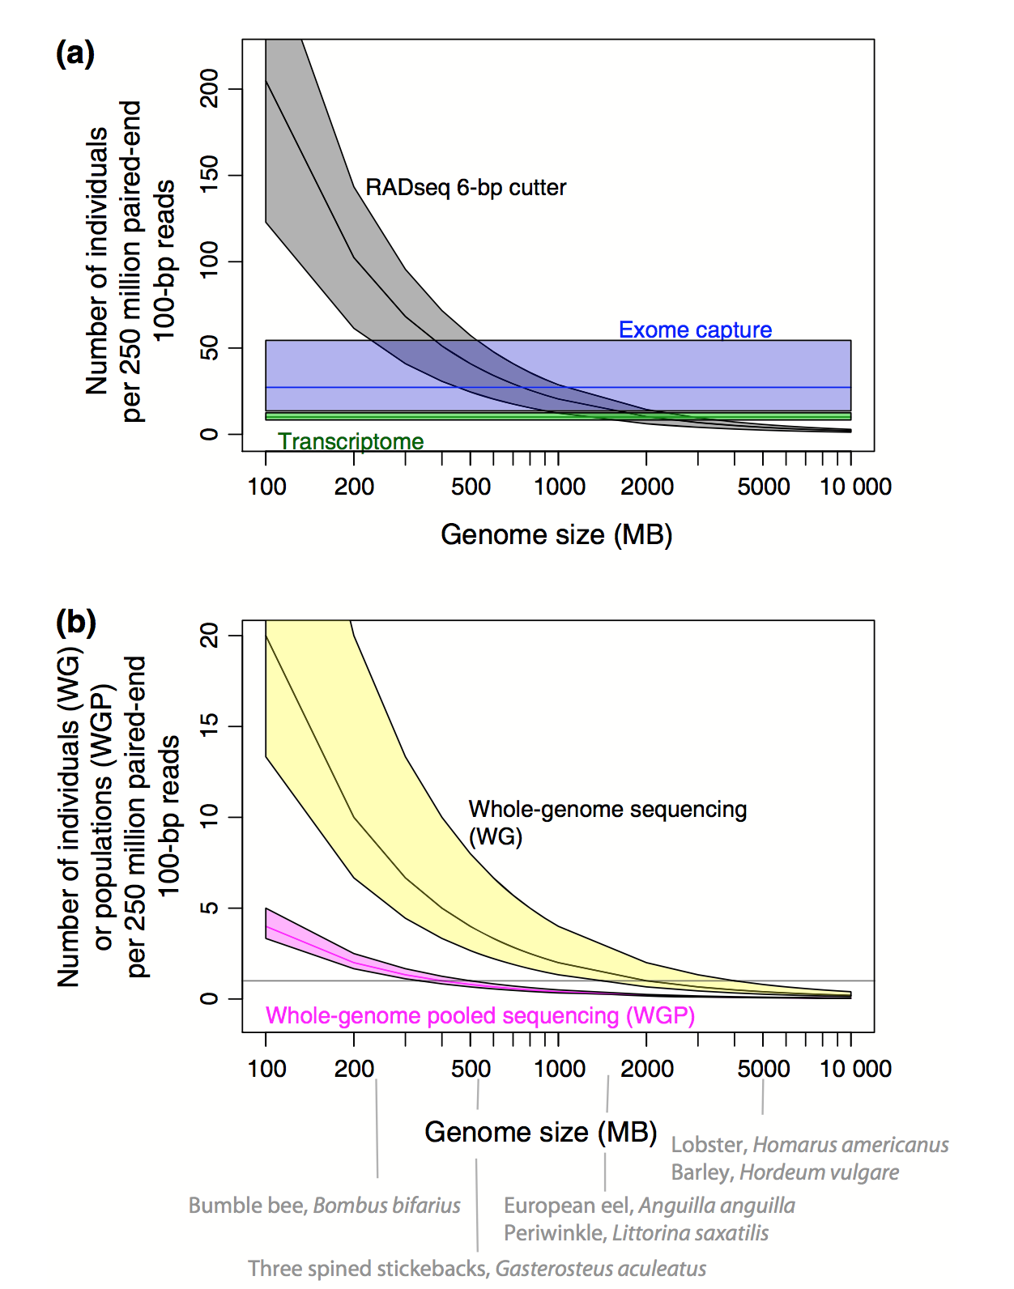
Understanding limitations

Slide 42
Is RAD broken?
There is no perfect method!
Linkage block size should inform experimental design
For surveying neutral AND adaptive variation in non-model organisms, it’s hard to beat RADseq.
38
Ra
For now...

Slide 43
RADseq Methods
B @ G³
i
o
i
n
for
o
r
m
a
t
i
c
s
d
a
p
t
a
t
i
o
n
e
n
o
m
i
c
s

Slide 44
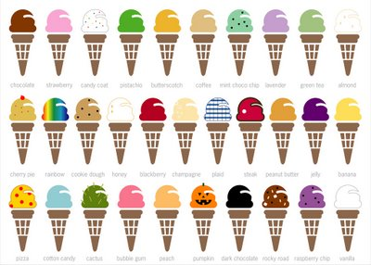
The many flavors of RAD
Original RAD (mbRAD)
Miller et al. 2007 and Baird et al. 2008
Double Digest RAD (ddRAD)
Peterson et al. 2012
2bRAD
Wang et al. 2012
ezRAD
Toonen et al. 2013

Slide 45
mbRAD
5’
3’
3’
5’

Slide 46
mbRAD
5’
3’
3’
5’
Protocol Steps
Digestion with one rare cutting enzyme
Barcoded adapters ligated to fragments
Ligated fragments are then sonicated
common adapter ligated to sheared ends
PCR enrichment
No size selection

Slide 47
ddRAD
5’
3’
3’
5’

Slide 48
ddRAD
5’
3’
3’
5’
Protocol Steps
Digestion with one rare and one common cutter
Barcoded adapter is ligated to one cut overhang
usually the rare cutter
2nd common adapter is ligated to other overhang
PCR enrichment
Size selection is used to reduce sampled genome

Slide 49
2bRAD
5’
3’
3’
5’

Slide 50
2bRAD
5’
3’
3’
5’
Protocol Steps
Digestion occurs with IIb restriction enzyme
Dual barcoded adapters are ligated to fragment
2nd common adapter is ligated to other overhang
PCR enrichment
Uniform sized fragments are gel excised

Slide 51
ezRAD
5’
3’
3’
5’

Slide 52
ezRAD
5’
3’
3’
5’
Protocol Steps
Digestion with one (two) common cutters
Digested DNA is inserted into commercial Illumina prep kit (Illumina or Kappa)
Library can be prepared with or without PCR
Size selection is used to reduce number of fragments

Slide 53
RAD Capture Methods
hyRAD
http://journals.plos.org/plosone/article?id=10.1371/journal.pone.0151651
RAcap
http://onlinelibrary.wiley.com/doi/10.1111/1755-0998.12566/abstract
Rapture
http://www.genetics.org/content/early/2015/12/22/genetics.115.183665

Slide 54
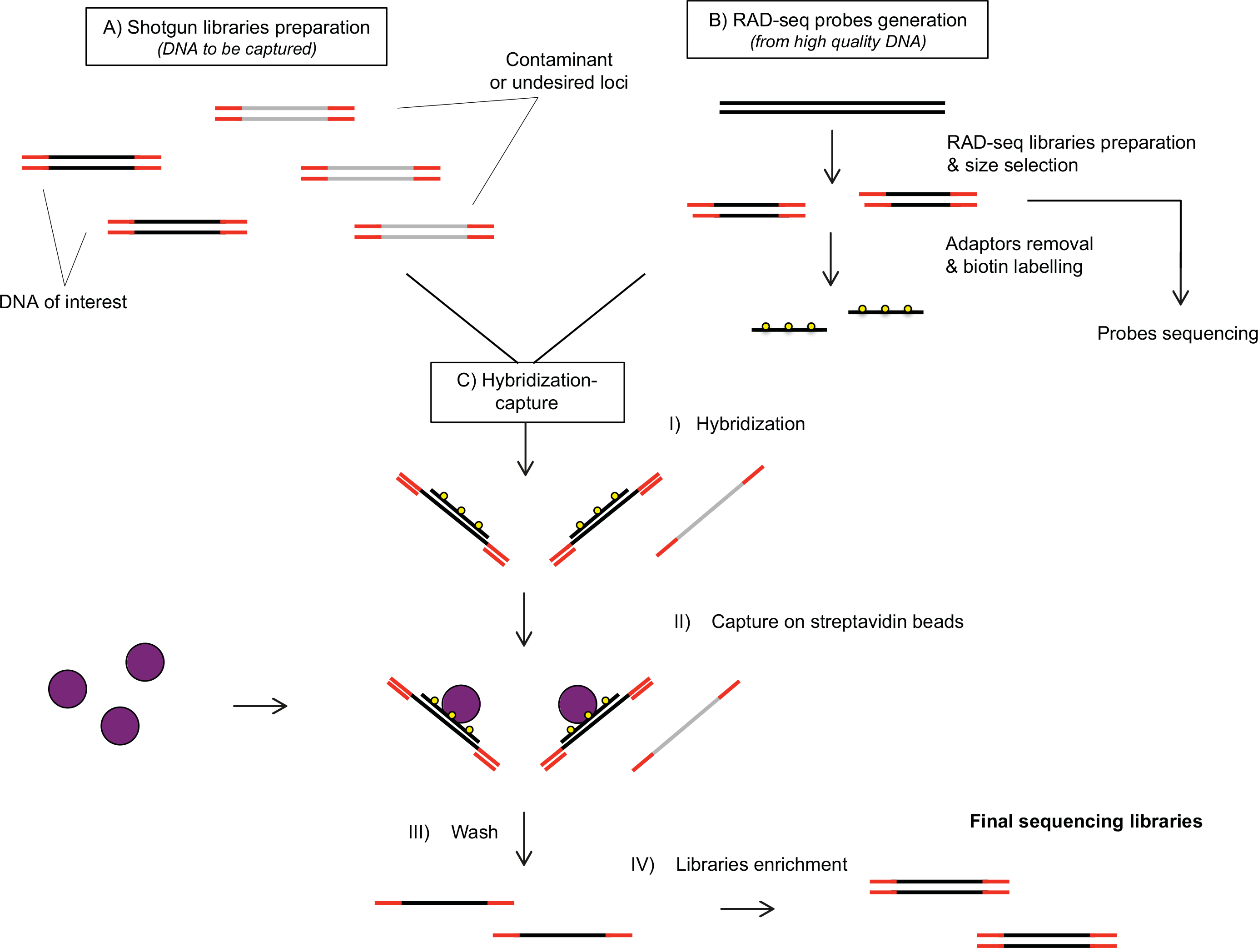
RAD Capture Methods

Slide 55
mbRAD
Advantages
The random shearing of the ends of fragments allows the putative identification of PCR duplicates
The random shearing leads to longer RAD loci and longer assembled contigs
Less susceptible to allele Drop out
Disadvantages
The lab protocol is the most technically challenging and requires extra equipment like a sonicator
There is a significant bias in mbRAD libraries relative to the original length of the restriction fragment.
Varying fragment sizes also makes mbRAD more susceptible to PCR bias

Slide 56
ddRAD
Advantages
The greatest degree of flexibility in terms of genome sampling
Can be easily multiplexed and relatively inexpensive
Less susceptible to PCR bias
Disadvantages
Size selection can bias the representation of alleles and loci across libraries
requires the highest initial quality of DNA
Two enzymes increases the change of allele dropout

Slide 57
2bRAD
Advantages
By far the easiest and cheapest protocol
No special cleanups
No special equipment
No bias from size selection
With specialized adapters the number of fragments sampled can be customizable
Disadvantages
There are a limited number and cut sites for IIb-type restriction endonucleases
Fragment and read lengths are much smaller than other methods and cannot be used build contigs.
Fragments are likely not mappable across species

Slide 58
ezRAD
Advantages
Use of commercial library prep kits that come with support and a guarantee
Digested DNA could simply be shipped off to almost any Illumina sequence providers
Combined with the proper commercial kit, ezRAD is the only RAD protocol that can be completed without PCR
Disadvantages
Commercial sequencing kits are quite expensive relative to “homebrew” library preps
All ezRAD sequencing reads start with the cut site and this reduced complexity can impact sequence quality
ezRAD relies heavily on size selection

Slide 59
RAD Capture Methods
Advantages
No longer dependent on enzymes for sampling loci
Less allele dropout
Lower quality DNA can be used
Disadvantages
Requires extra laboratory steps and costs
Unclear how consistent results are across different captures
Unclear how consistent results are across different sets of probes

Slide 60
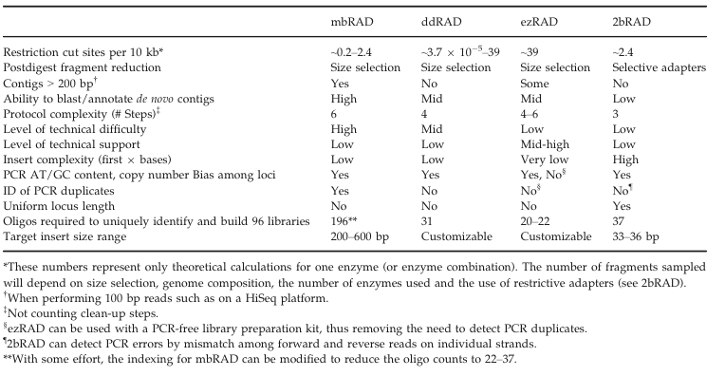
Let’s discuss!

Slide 61
Mitigating major RADseq Biases
Allele dropout
Restriction fragment length bias
PCR Bias
Size Selection/Library Effect bias
B@G 2017

Slide 62
Mitigating major RADseq Biases
Allele Dropout
This happens when there is a mutation in a cut site for a particular subset of individuals. Individuals with this mutation will not have reads at this genomic location
5’
3’
IND 1
3’
5’
5’
3’
IND 2
3’
5’
B@G 2017

Slide 63
Mitigating major RADseq Biases
Allele Dropout
This happens when there is a mutation in a cut site for a particular subset of individuals. Individuals with this mutation will not have reads at this genomic location
Will reduce overall estimates of genetic diversity and heterozygosity
Simulations suggest that RADseq methods that utilizing more than one enzyme may be more sensitive to this bias than mbRAD
Mitigated bioinformatically
Using a high call rate percentage
Removing loci that show a wide variance of depth across individuals
Software package GBStools (http://journals.plos.org/plosgenetics/article?id=10.1371/journal.pgen.1005631)
B@G 2017

Slide 64
Mitigating major RADseq Biases
Restriction fragment length bias
This happens when shorter restriction fragments are not completely sonicated relative to larger ones. They get lower levels of coverage and are more likely to suffer allele and locus dropout (Davey et al. 2013)
Mitigate by avoiding mbRAD
Bias is only present in the mbRAD protocol
Adjust enzyme choice and experiment with different sonication techniques
B@G 2017

Slide 65
Mitigating major RADseq Biases
PCR bias
PCR biases the relative coverage of loci and can bias the relative coverage of alleles (though this is more likely in mbRAD relative to others).
PCR bias can be mitigated several ways:
Experimentally
PCR enrichment can be modified to reduce bias (Aird et al. 2012; Oyola et al. 2012)
PCR can be removed from library prep in ezRAD
Degenerate tags can be added to adapters to help distinguish duplicates (Casbon et al. 2011; Schweyen et. al 2014)
Replicate libraries can be used to model library prep error
Bioinformatically
The length and alignment of randomly sheared fragments can be used to identify duplicates. Though, this is only applicable to mbRAD
B@G 2017

Slide 66
Mitigating major RADseq Biases
Size selection/Library bias
This bias occurs when inconsistency in size selection leads to locus (or even worse) allele dropout
B@G 2017

Slide 67
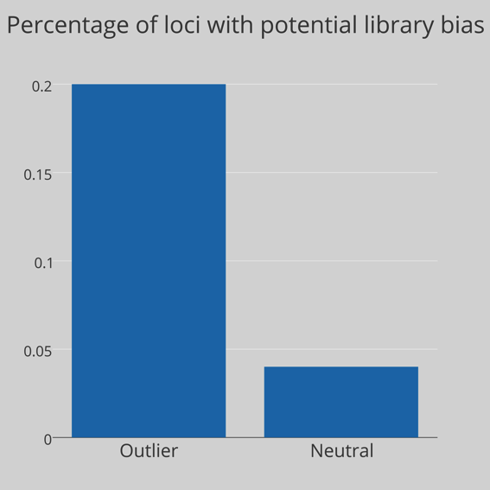
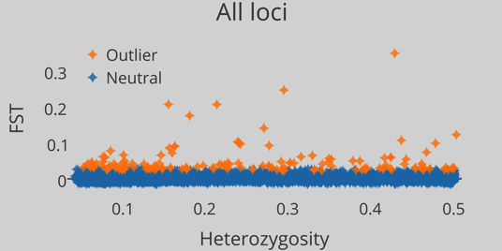
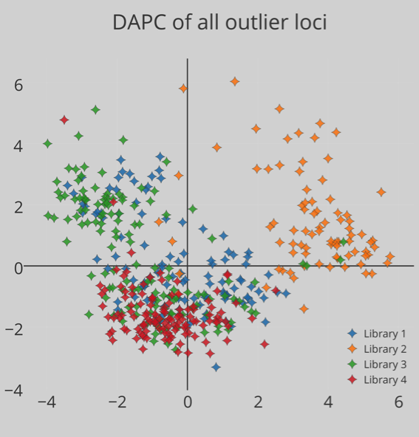
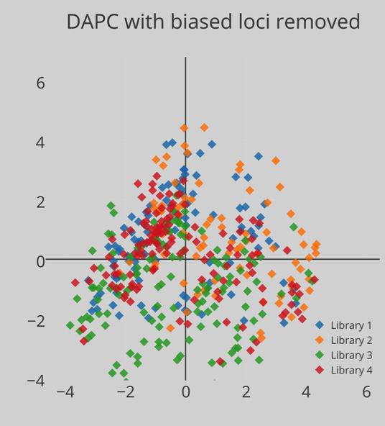
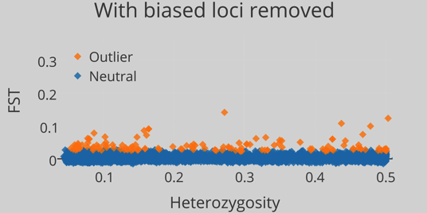
http://figshare.com/articles/Puritz_PAGXIII_Poster_1025/1287474

Slide 68
Mitigating major RADseq Biases
Size selection/Library bias
This bias occurs when inconsistency in size selection leads to locus (or even worse) allele dropout
Size selection bias can be mitigated in several ways
Using an automated instrument like a Pippin prep
Spreading samples from the same locality across different libraries
Use a RADseq protocol like mbRAD or 2bRAD that does not utilize size selection
Choosing an enzyme or combination that has a less frequent cut site and then using a larger size selection window
B@G 2017

Slide 69
RAD Experimental Design
Improving de novo assembly with a MiSeq library
Enzyme Choice
B@G 2017

Slide 70
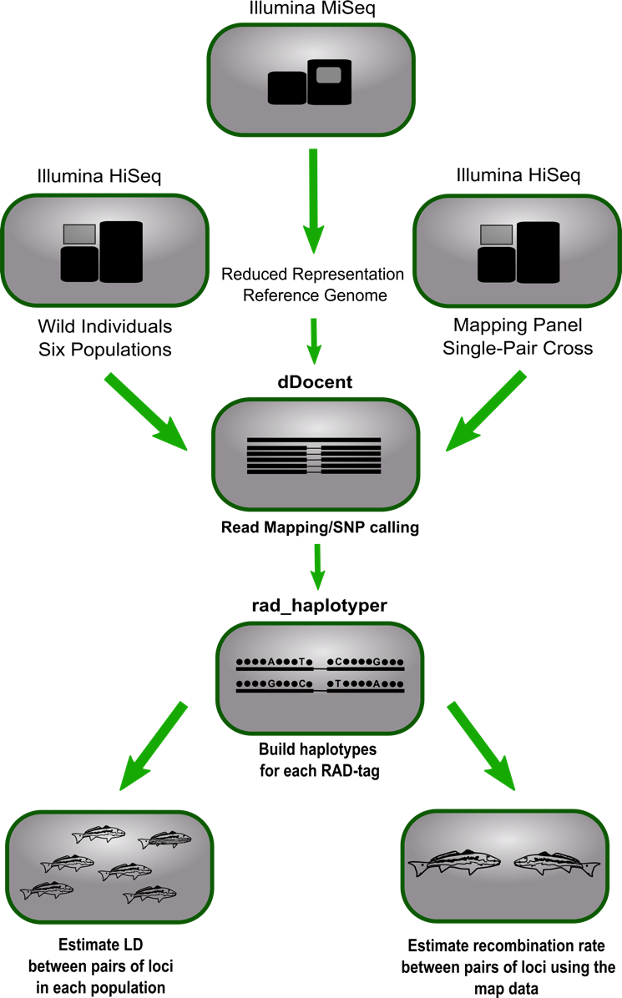
Improving de novo assembly
Our lab is now starting to use a single MiSeq run of 300 bp PE to help generate a more accurate set of reference contigs
B@G 2017

Slide 71
The Power of MiSeq
5’
3’
3’
5’
B@G 2017

Slide 72
The Power of MiSeq
5’
3’
3’
5’
B@G 2017

Slide 73
Using a MiSeq Reference
Our lab is now starting to use a single MiSeq run of 300 bp PE to help generate a more accurate set of reference contigs
So far we have had a significant improvement to the number of reads that map to the MiSeq contigs relative the HiSeq derived reference contigs.
One MiSeq run can also genotype ~20 individuals
B@G 2017

Slide 74

Choosing the right enzyme
Number of genomic fragments sampled
Genome size
Enzyme choice
Size selection
Take the time to plan make informed enzyme choices
B@G 2017

Slide 75
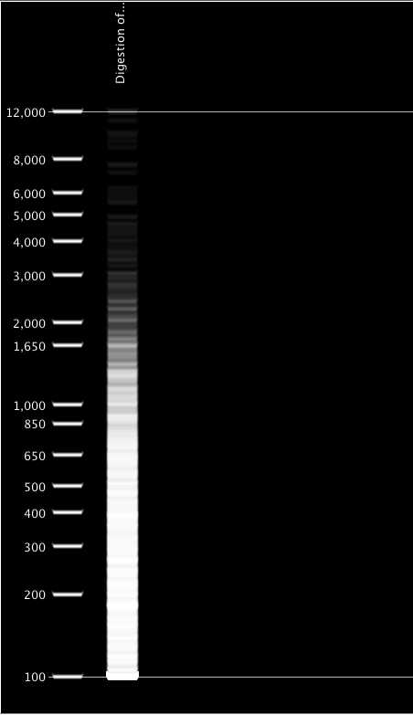
Choosing the right enzyme
If you have a close reference genome
SIMULATE
Geneious
SimRAD R package
Webcutter
http://rna.lundberg.gu.se/cutter2/
B@G 2017

Slide 76
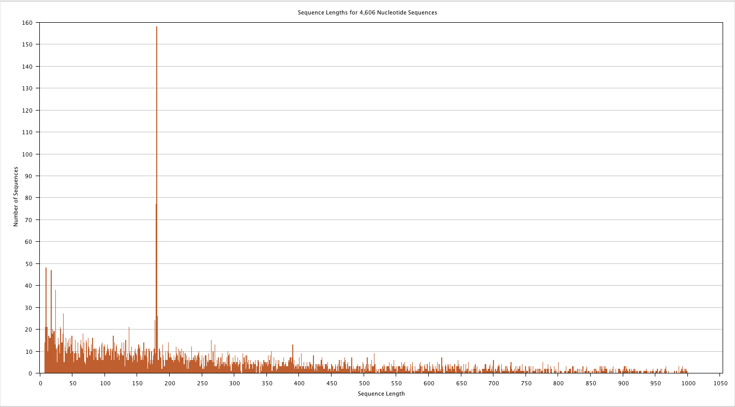
Choosing the right enzyme
If you have a close reference genome
SIMULATE
Geneious
BioEdit
Webcutter
http://rna.lundberg.gu.se/cutter2/
B@G 2017

Slide 77
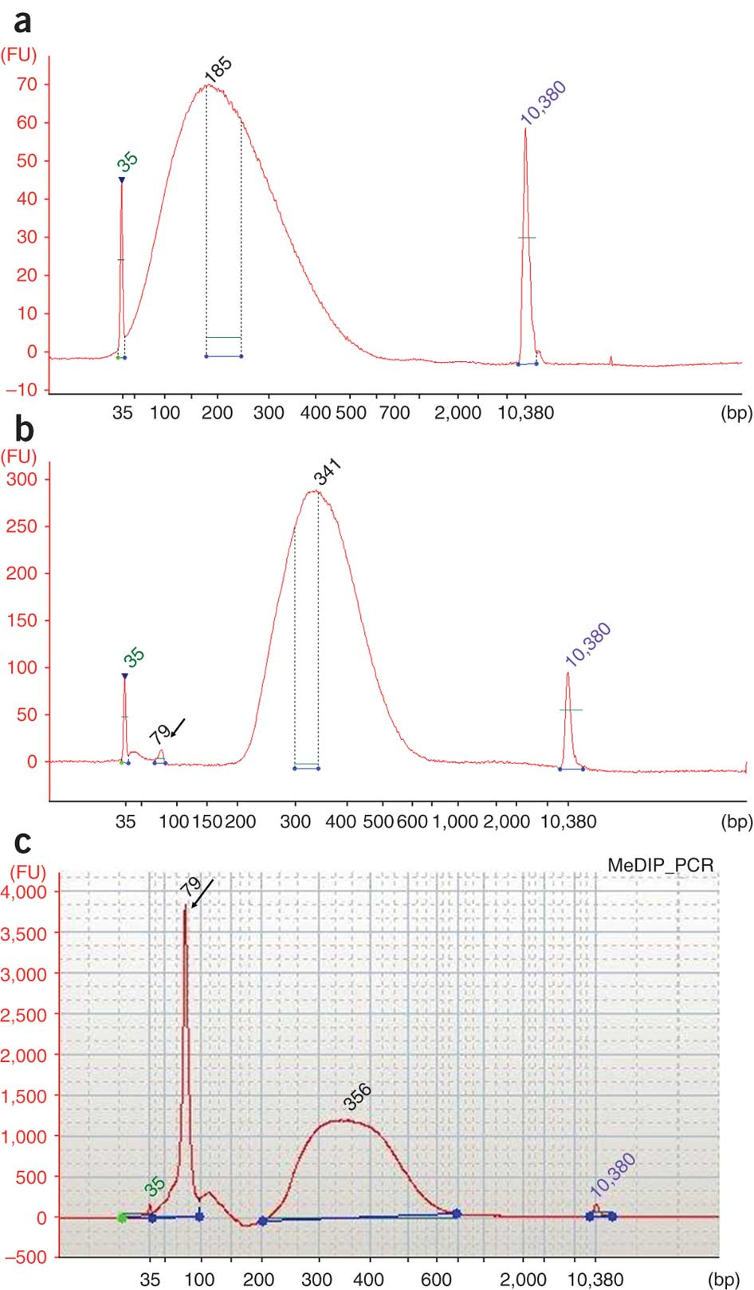
Let’s be honest...
You probably don’t have a genome
An educated guess
Calculate the probability of the cut sequence in your genome
Should be adjusted for GC content
Multiply this probability by the size of your genome
Divide by half for ezRAD
Experiment
Combine trials and fragment analysis
See protocol at https://docs.google.com/document/d/1QY0LndEUywyGmOBCF7xDQeI_f5MNB_T3lKwSSvbFtX4/edit
B@G 2017

